Slide 1
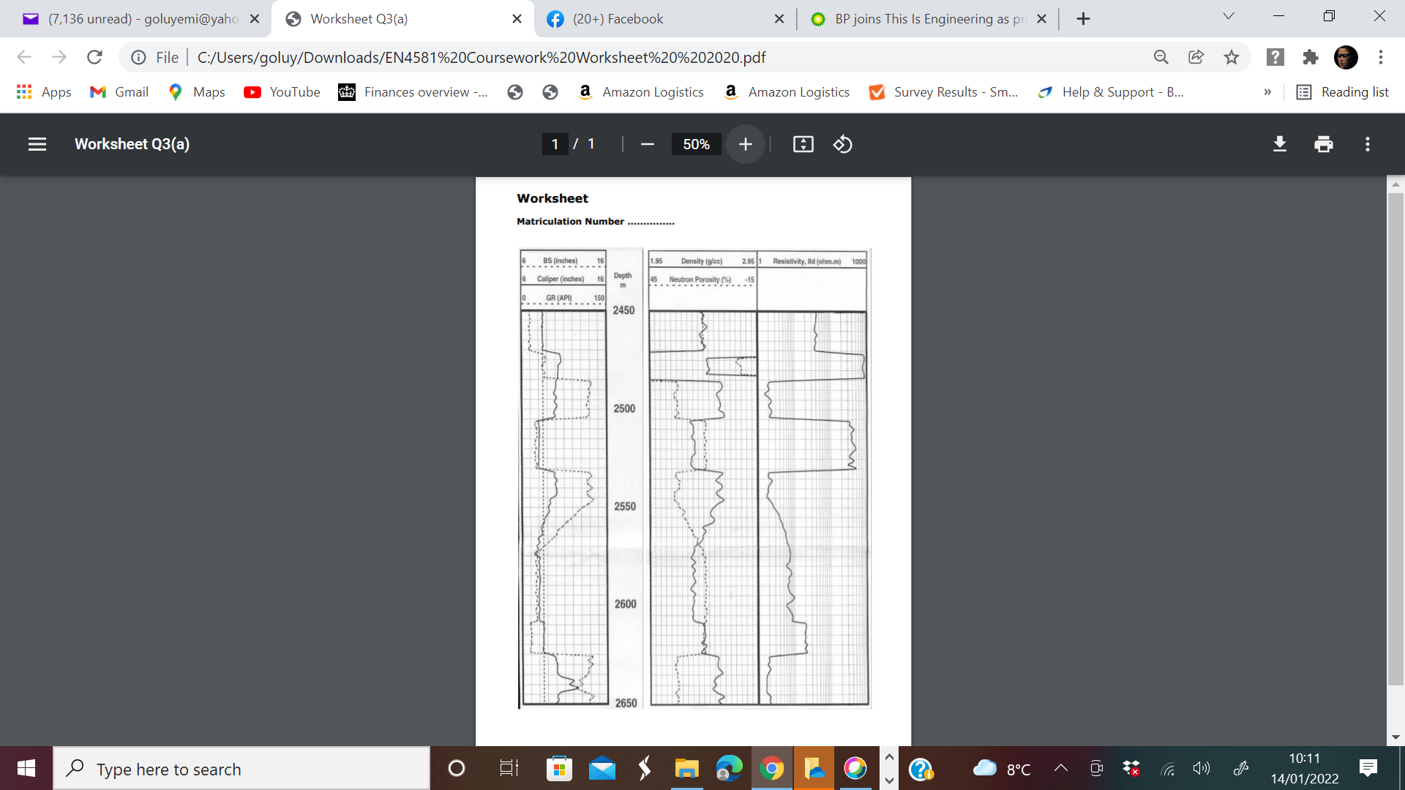
Sand
Coarsening upwards sequence/barrier bars
Gas zone
GOC
Shale
Uniform deposit/deltaic deposit
Zone of interest
Sand
Oil zone
OWC
Shale
Uniform deposit and fining upward sequence
Sand
Water zone
Shale

